Slide 1
vegawidget
Composing and Rendering Interactive Vega(-Lite) Charts

Slide 2
vegawidget
Using Vega-Lite in the browser
Rendering Vega-Lite specifications as htmlwidgets
Composing Vega-Lite specifications

Slide 3


vegawidget
Ian Lyttle, Schneider Electric @ijlyttle
Alicia Schep, Livongo @AliciaSchep
Stuart Lee, Monash University @_StuartLee
Haley Jeppson, Iowa State University @heyhayhay__
Wenyu Yang, George Washington University @iuysa1
Heike Hofmann, Iowa State University @heike_hh

Slide 4
vegawidget
What is vegawidget?
CRAN package to render Vega-Lite specs
GitHub organization with packages to help build and work with Vega-Lite specs in R

Slide 5
Vega-Lite
Interactive grammar-of-graphics, rendered in the browser
Built on Vega: Vega-Lite is more concise, but less expressive
Developed by Interactive Data Lab, U Washington
Foundation for vegalite R package by Bob Rudis et al.

Slide 6
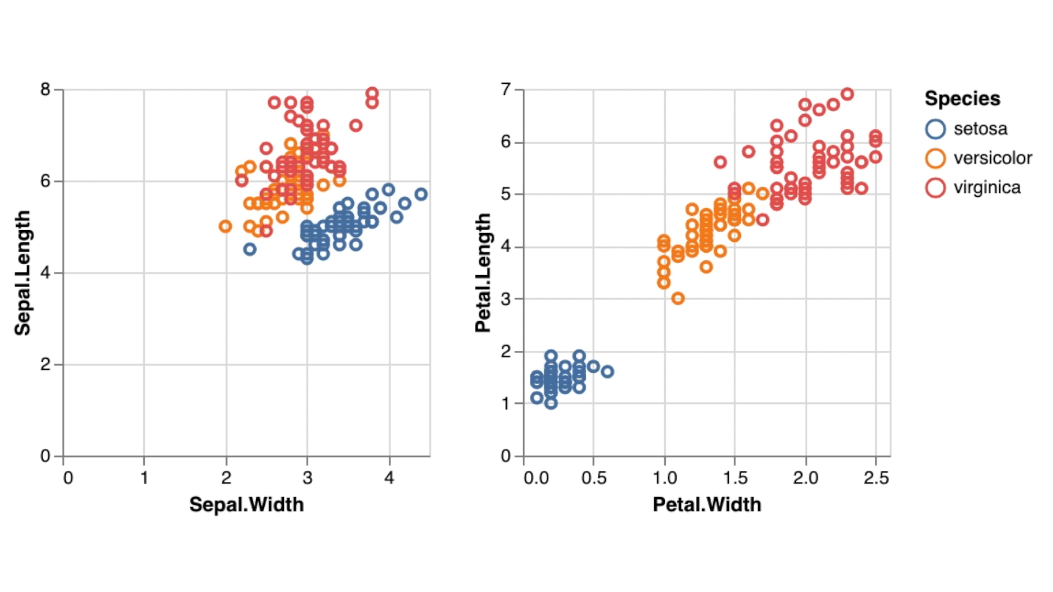
Vega-Lite: linked brushing
[link]

Slide 7
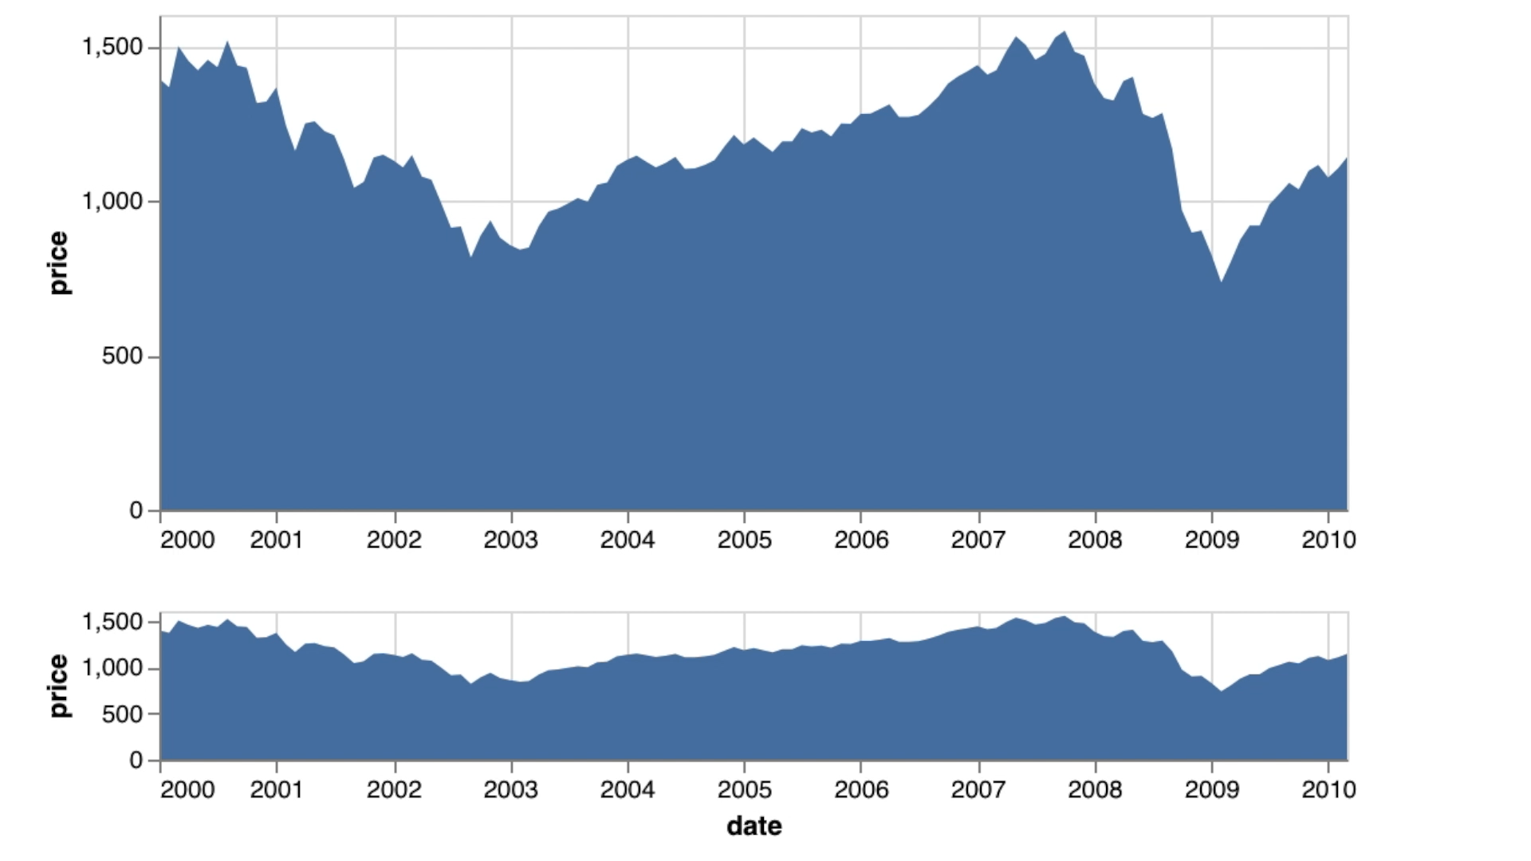
[link]
Vega-Lite: overview and detail

Slide 8
Grammar-of-Graphics
Grammar-of-Graphics as Food
salt
fat
acid
heat
by Samin Nosrat
art by Wendy MacNaughton

Slide 9
ggplot2
data
stat
aes
geom

Slide 10
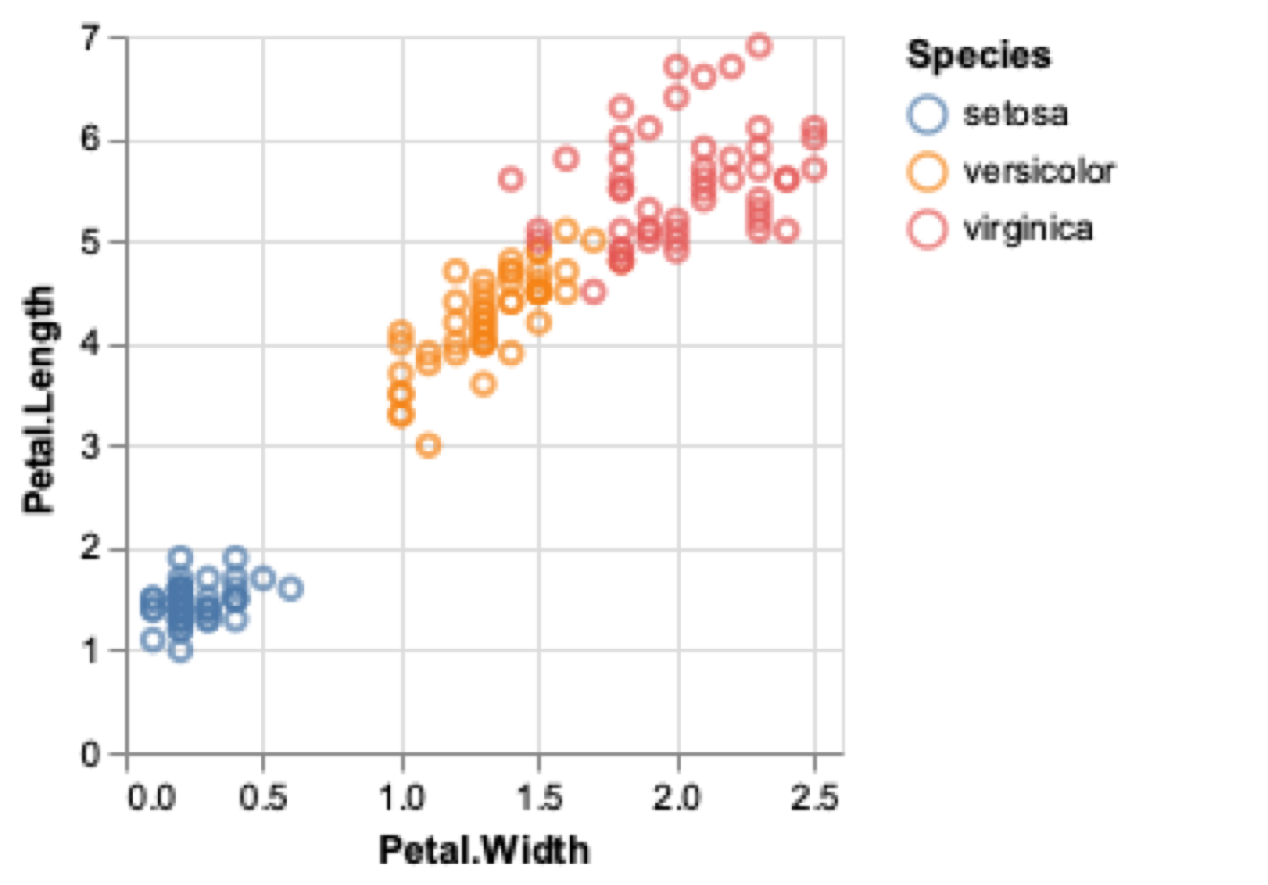
Vega-Lite
data
transform
encoding
mark

Slide 11
Vega-Lite
{
"data": {"values": [{Petal.Width = 0.1, …}, …]},
"mark": "point",
"encoding": {
"x": {
"field": "Petal\\.Width",
"type": "quantitative",
"title": "Petal.Width"
},
"y": {
"field": "Petal\\.Length",
"type": "quantitative",
"title": "Petal.Length"
},
"color": {"field": "Species", "type": "nominal"}
}
}

Slide 12
Vega-Lite
Compose
Render
💡
📊
👀
Specification
Icons made by Smashicons from www.flaticon.com

Slide 13


vegawidget
Ian Lyttle
Alicia Schep
Stuart Lee
htmlwidget
renders Vega(-Lite) specifications
provides access to interactivity
intended as low-level package
use vegawidget to render
use other packages to compose
https://vegawidget.github.io/vegawidget

Slide 14
vegawidget
list(
data = list(values = iris),
mark = "point",
encoding = list(
x = list(
field = "Petal\\.Width",
type = "quantitative",
title = "Petal.Width"
),
y = list(
field = "Petal\\.Length",
type = "quantitative",
title = "Petal.Length"
),
color = list(field = "Species", type = "nominal")
)
) %>%
as_vegaspec()

Slide 15
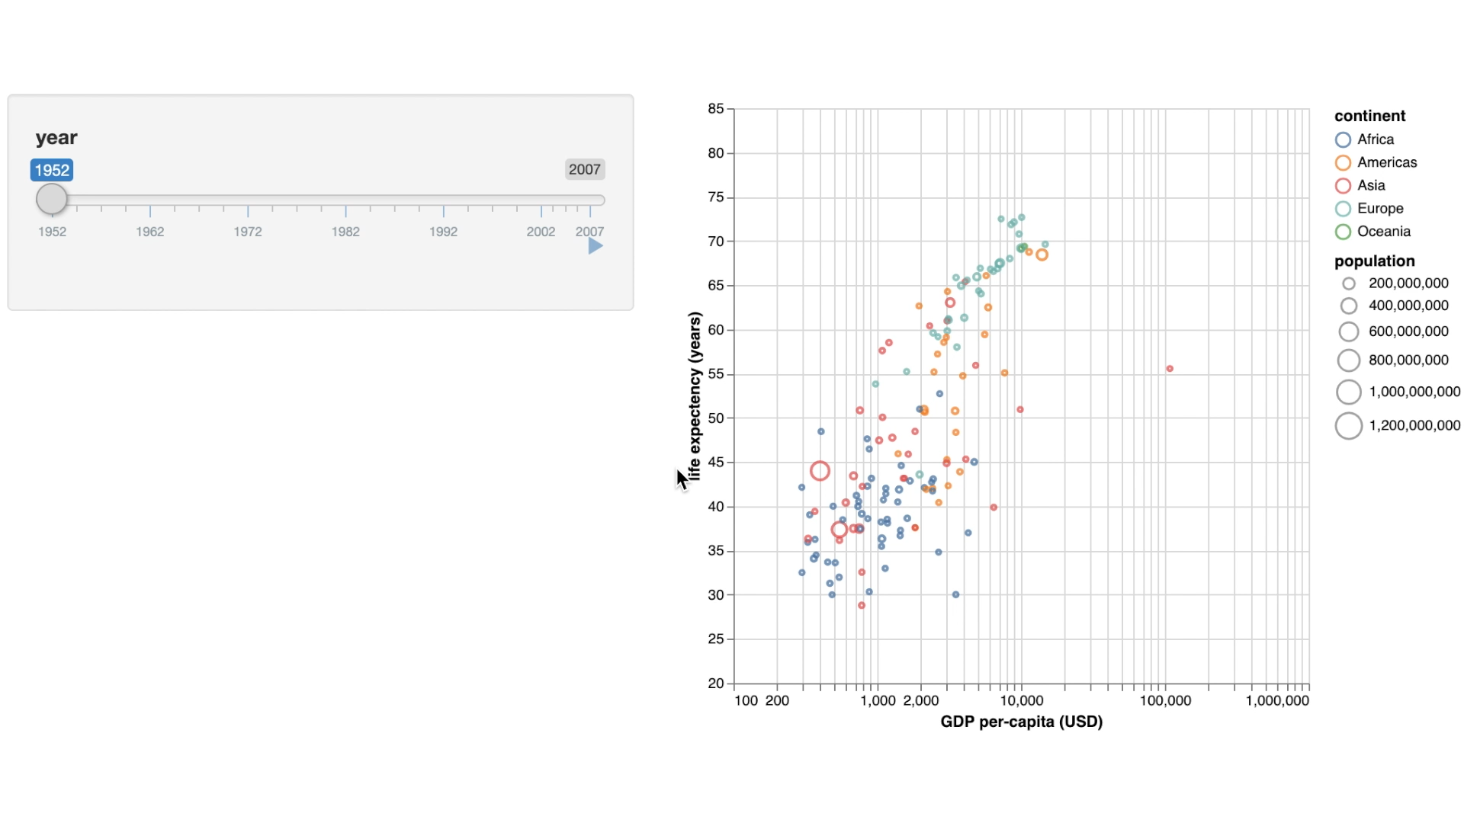
vegawidget
Interactivity
Vega gives access (via JS) to its:
data
signals (reactive variables)
events
vegawidget gives access via Shiny
Shiny app by Stuart Lee

Slide 16
vegawidget
[link]

Slide 17

altair
Ian Lyttle
Haley Jeppson
Alicia Schep
wraps Python Altair (via reticulate)
by Jake VanderPlas, Brian Granger
covers entire Vega-Lite API
concise syntax
https://altair-viz.github.io
altair example-gallery
reproduces entire Altair gallery
https://vegawidget.github.io/altair

Slide 18
altair
alt$Chart(iris)$
mark_point()$
encode(
alt$X(
"Petal\\.Width:Q",
title = "Petal.Width”
),
alt$Y(
"Petal\\.Length:Q",
title = "Petal.Length”
),
color = "Species:N"
)$
properties(width = 300, height = 300)

Slide 19

vlbuildr
Alicia Schep
API heavily inspired by vegalite (R)
builds API semi-automatically based on the Vega-Lite schema
inspired by Altair (Python), vega-lite-api (JS)
compose Vega-Lite specs using %>%
https://vegawidget.github.io/vlbuildr

Slide 20
vlbuildr
vl_chart() %>%
vl_add_data(values = iris) %>%
vl_mark_point() %>%
vl_encode_x(
field = "Petal\\.Width:Q",
title = "Petal.Width"
) %>%
vl_encode_y(
field = "Petal\\.Length:Q",
title = "Petal.Length"
) %>%
vl_encode_color("Species:N")

Slide 21
ggvega
Haley Jeppson
Wenyu Yang
Ian Lyttle
translate from ggplot2 to Vega-Lite
supported by Google Summer of Code
obvs. inspired by plotly, Carson Sievert
ggplot2 & Vega-Lite are declarative
“what” not “how”
ggvega translates only the declarations
build & deploy Vega-Lite templates
https://vegawidget.github.io/ggvega

Slide 22
ggvega
library("ggplot2")
library("ggvega")
gg_petal <-
ggplot(iris) +
geom_point( aes( x = Petal.Width, y = Petal.Length, colour = Species )
)
as_vegaspec(gg_petal)

Slide 23
Mix-and-Match
library("ggplot2")
library("ggvega")
library("vlbuildr")
gg_petal <-
ggplot(iris) +
geom_point( aes( x = Petal.Width, y = Petal.Length, colour = Species )
)
as_vegaspec(gg_petal)
library("ggplot2")
library("ggvega")
gg_petal <-
ggplot(iris) +
geom_point( aes( x = Petal.Width, y = Petal.Length, colour = Species )
)
as_vegaspec(gg_petal)

Slide 24
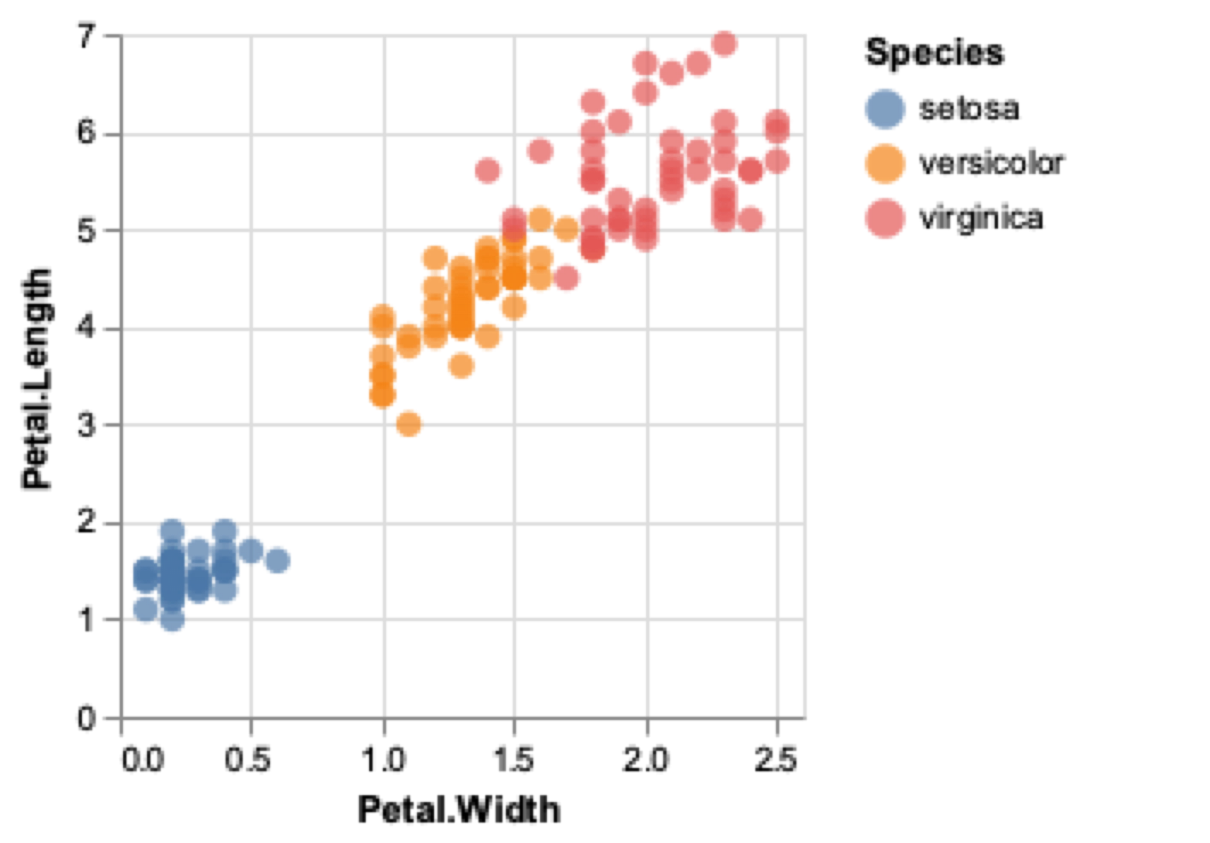
Mix-and-Match
library("ggplot2")
library("ggvega")
library("vlbuildr")
gg_petal <-
ggplot(iris) +
geom_point( aes( x = Petal.Width, y = Petal.Length, colour = Species )
)
as_vegaspec(gg_petal) %>%
vl_encode_fill("Species:N")

Slide 25
Add interactivity
# experiment: https://rstudio.cloud/project/398318
vl_petal <-
as_vegaspec(gg_petal) %>%
experimental_function_to_operate_on_layer({
. %>%
vl_encode_opacity(value = 0.3) %>%
vl_add_interval_selection("brush") %>%
vl_condition_opacity(
selection = "brush",
value = 1
)
})
# do the same with vl_sepal
# concatenate
vl_hconcat(vl_sepal, vl_petal)

Slide 26
Add interactivity
[link]

Slide 27
Summary
Vega-Lite
Compose
Render
💡
📊
👀
Specification
Icons made by Smashicons from www.flaticon.com

Slide 28
Summary
Vega-Lite
Compose
Render
💡
📊
👀
Specification
📚 Vega-Lite - interactive grammar-of-graphics
- JavaScript, rendered in the browser
📦 vegawidget - htmlwidget, render Vega-Lite specifications
- provides interactive access to Vega-Lite charts
📦 altair
📦 vlbuildr - compose Vega-Lite specifications
📦 ggvega

Slide 29
vegawidget
Ian Lyttle
@ijlyttle
Alicia Schep
@AliciaSchep
Stuart Lee
@_StuartLee
Haley Jeppson
@heyhayhay__
Wenyu Yang
@iuysa1
Heike Hofmann
@heike_hh

Slide 30
vegawidget
Composing and Rendering Interactive Vega(-Lite) Charts
vegawidget organization https://github.com/vegawidget
📌 packages with pkgdown sites
https://vegawidget.rbind.io
Vega-Lite (JS) https://vega.github.io/vega-lite
Altair (Python) https://altair-viz.github.io

